Slide 1


Weekly Mariam Update
Mariam Rabadi
Butterfly implementation
CECS

Slide 2
Outline:
Found out how the twiddle factor array is organized and how to integrate it into a 4 input butterfly.
Wrote code with John using that finding and it performed a 4 input butterfly correctly.
Analyzed HEAX architecture and access patterns.

Slide 3
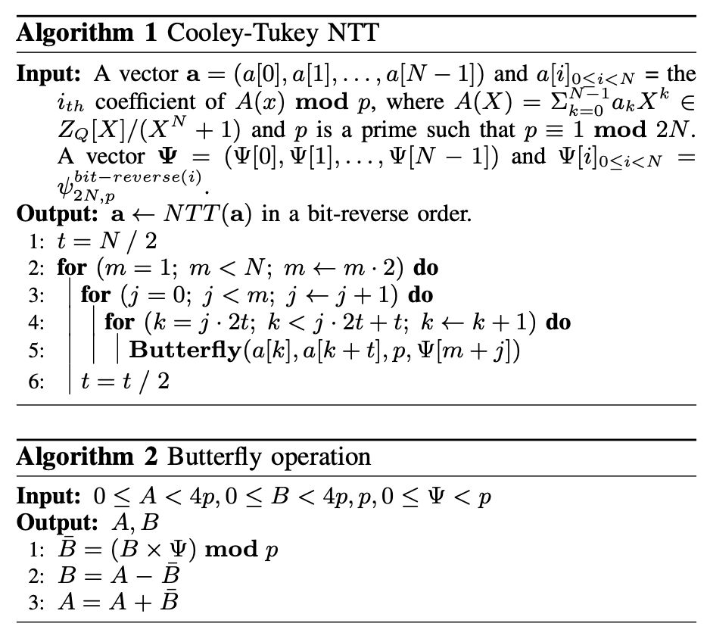
This code shows an array of psi_1 values but does not include the array, what are those values?
Notes:
Accelerating Number Theoretic Transformations for Bootstrappable Homomorphic Encryption on GPUs
Number Theoretic Transform and Its Applications in Lattice-based Cryptosystems: A Survey

Slide 4
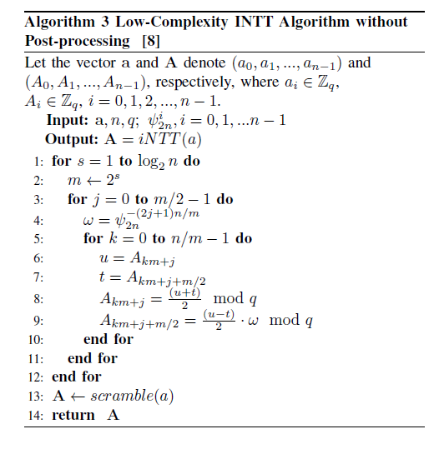
Look at this code for guidance
Notes:
NTT-Based Polynomial Modular Multiplication for Homomorphic Encryption: A Tutorial

Slide 5
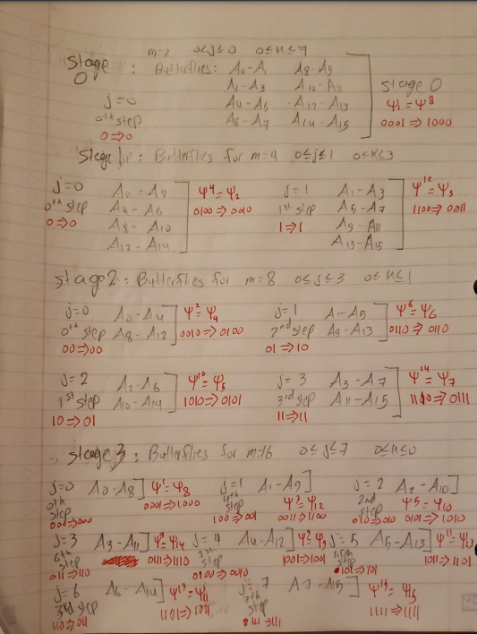

Slide 6
Explanation:
Psi is raised to the power of the its index in bit reverse order.
Psi[1] = psi^8. The conversion depends on the number of bits you need to represent psi. We need 4 bits in the analysis because n = 16 was used as the number of inputs. 0001 is converted to 1000, 0101 is converted to 1010 and so on.
m in this example is double the m in the base code, taking log of m gives which stage you are on, and the stage index is log m -1. First stage (stage[0]) has m=2.
j is used to show which step in the stage we are in, but in bit reverse order. Number of bits to use for j also depends on how much j varies. For stage 0 we had 1 j, so we used zero bits, for stage 3 we had 8 js, so we used three bits. When j = 1 in the third stage, 001 becomes 100, so we’re actually on the fourth step (index 4, by count it is the fifth stage).
The indices of A are also in bit reverse order (see right side of butterfly). A1 is actually A8 (conversion depends again on number of inputs and bits).
K represents the kth element in each step, j the step number (in bit reverse order) and m/2 the distance between each element and the element it does a butterfly with.

Slide 7

Butterfly (m and j are not the same ones from last slide)

Slide 8
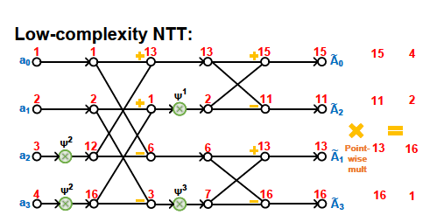
Psi^2 in this example is psi[1] from base code. Only four inputs so need 2 bits. 01 (one) becomes 10 (two). So first index (we start indexing from one) carries psi to the power of 2
Psi^1= psi[2]
Psi^3=psi[3]
This can be applied to the 16 input butterfly in the previous slide.
Remember to mod by q after multiplication by psi and after addition or subtraction
Notes:
NTT-Based Polynomial Modular Multiplication for Homomorphic Encryption: A Tutorial

Slide 9
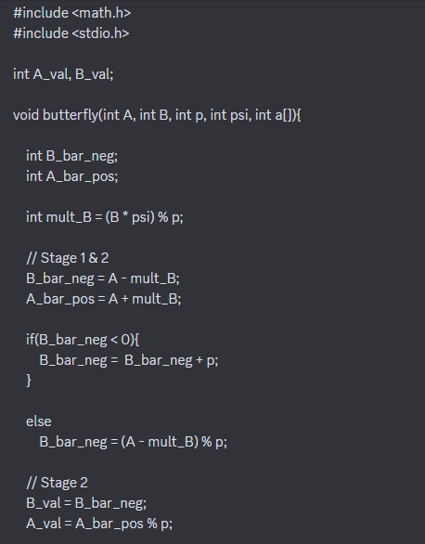
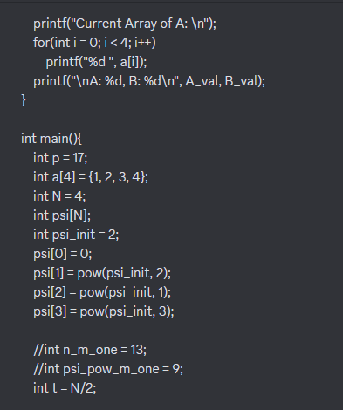
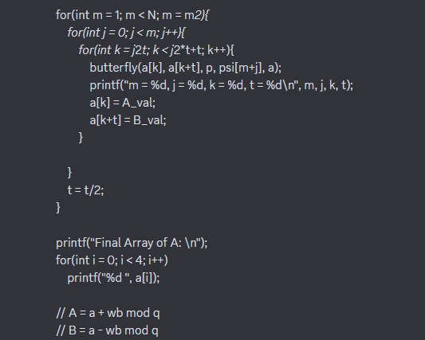
Code

Slide 10
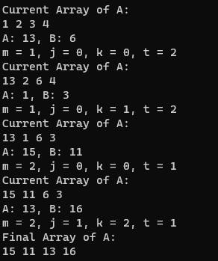
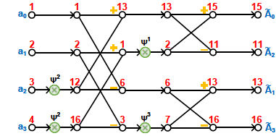
Output and butterfly

Slide 11
Summary:
This code helped to be able to write a complete code for the butterfly because the psi array is now known. It also shows how to implement the butterfly completely through creating a new array in which the values are saved in bit reverse order.

Slide 12
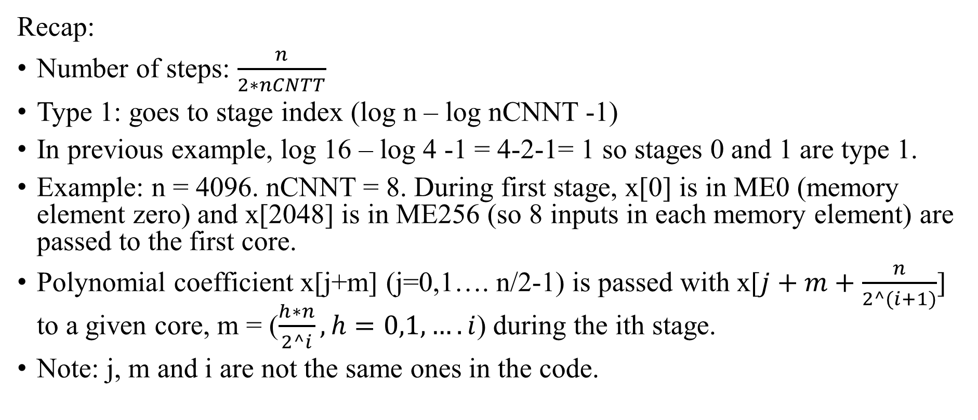
HEAX paper architecture
Recap:
Number of steps: $\frac{n}{2∗nCNTT}$
Type 1: goes to stage index (log n – log nCNNT -1)
In previous example, log 16 – log 4 -1 = 4-2-1= 1 so stages 0 and 1 are type 1.
Example: n = 4096. nCNNT = 8. During first stage, x[0] is in ME0 (memory element zero) and x[2048] is in ME256 (so 8 inputs in each memory element) are passed to the first core.
Polynomial coefficient x[j+m] (j=0,1…. n/2-1) is passed with x[$j+m+\frac{n}{2^(i+1)}$] to a given core, m = ($\frac{h∗n}{2^i}, h=0,1,….i$) during the ith stage.
Note: j, m and i are not the same ones in the code.

Slide 13
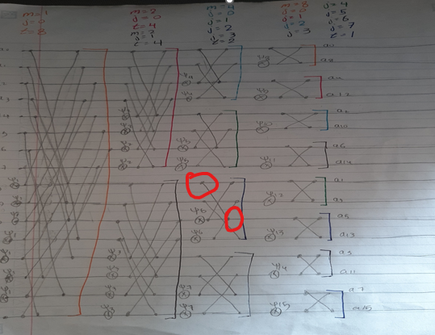
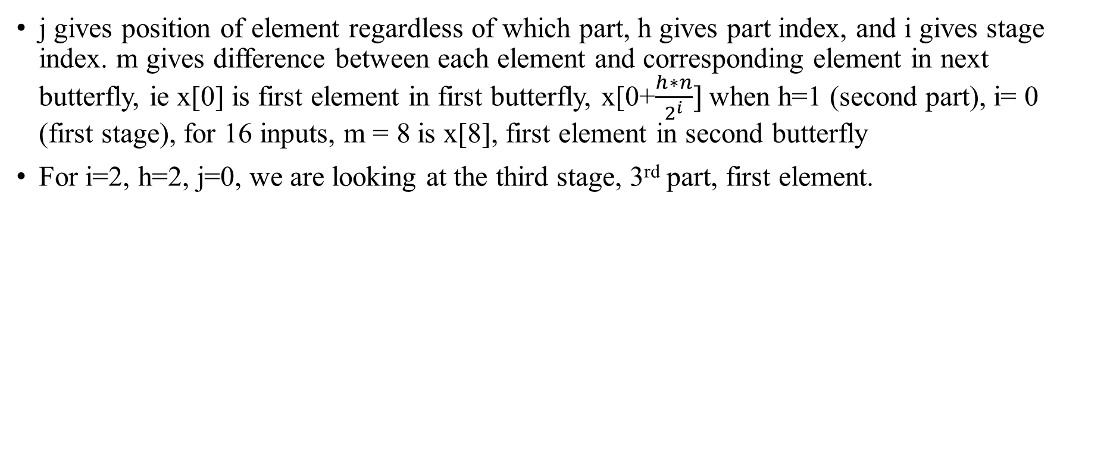
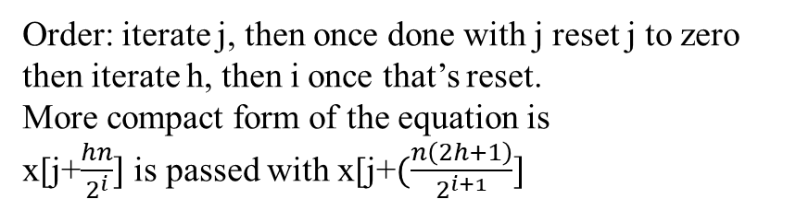
More elaboration on access pattern
j gives position of element regardless of which part, h gives part index, and i gives stage index. m gives difference between each element and corresponding element in next butterfly, ie x[0] is first element in first butterfly, x[0+$\frac{h∗n}{2^{i}}]$when h=1 (second part), i= 0 (first stage), for 16 inputs, m = 8 is x[8], first element in second butterfly
For i=2, h=2, j=0, we are looking at the third stage, 3rd part, first element.
Order: iterate j, then once done with j reset j to zero then iterate h, then i once that’s reset.
More compact form of the equation is
x[j+$\frac{hn}{2^{i}}]$ is passed with x[j+$(\frac{n\left(2h+1\right)}{2^{i+1}}]$

Slide 14
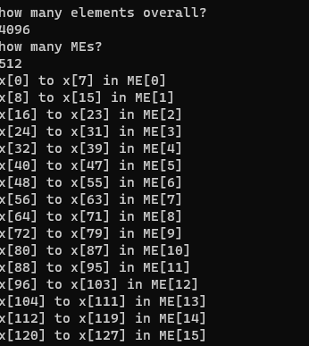
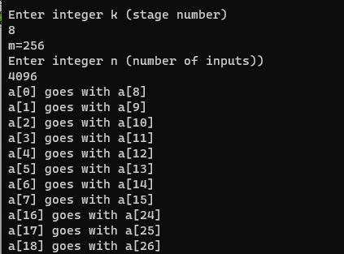
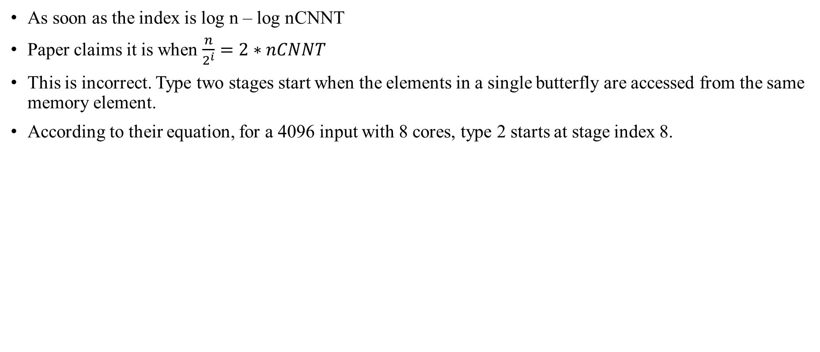
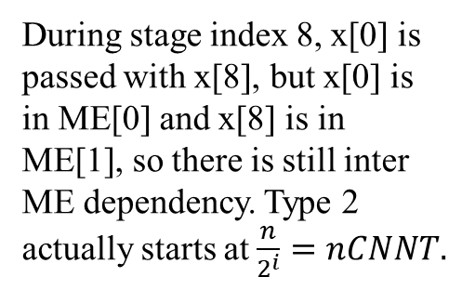
When do type 2 stages start?
As soon as the index is log n – log nCNNT
Paper claims it is when $\frac{n}{2^{i}}=2∗nCNNT$
This is incorrect. Type two stages start when the elements in a single butterfly are accessed from the same memory element.
According to their equation, for a 4096 input with 8 cores, type 2 starts at stage index 8.
During stage index 8, x[0] is passed with x[8], but x[0] is in ME[0] and x[8] is in ME[1], so there is still inter ME dependency. Type 2 actually starts at $\frac{n}{2^{i}}=nCNNT.$

Slide 15
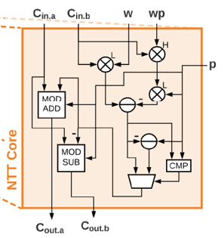
Characteristics of architecture
During type 1, first element in each ME goes to first NTT core, second to second core, and so on.
There are 2^i twiddle factors in each stage i, and in the worst case we are using nCNTT different twiddle factors in one step, so twiddle factors are stored in batches of size nCNTT.
W is a twiddle factor, p is the mod, and wp is a precomputed value.

Slide 16
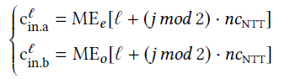
Type 1 access pattern
j is the step number, l is the lth core, a is the first passed element and b is the second passed element.
During step 0, j mod 2 =0, and MEe has only nCNNT elements.
During step 1, j mod 2 =1, and MEe has 2nCNNT elements.
MEe and MEo hold up to 2*nCNNT elements.
Explanation: for 4 cores, l goes up to 3, so during step 0 we fill MEe[0+0]= MEe[0] to MEe[3+0]=MEe[3], then during step 1, we fill MEe[0+4]=MEe[4] to MEe[3+4]=MEe[7]. If we have a step 2, then j mod 2 is zero again, and we overwrite the previous values in MEe[0] to MEe[3]
Same applies for MEo.

Slide 17
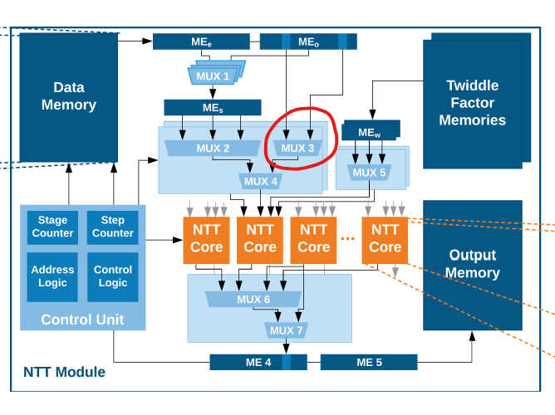
MUX 3
Mux 3 here is used to choose between the two possible positions a core can access an element from.

Slide 18
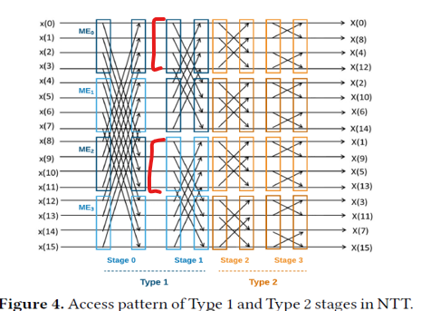
For example:
For a 16 input 4 core problem, during stage 1 MEe = [a0 a1 a2 a3 a8 a9 10 a11]
The first core, during step 0 accesses a0, and during step 1 accesses a8, so
MUX3 is choosing between MEe[0] and MEe[4] for element a for the 0th core, depending on the step number.
Note, if n> 4*nCNNT then not all the elements will be in MEe and MEo at once, values need to be overwritten to be passed to the cores since MEe and Meo can individually only hold 2*nCNNT elements.

Slide 19
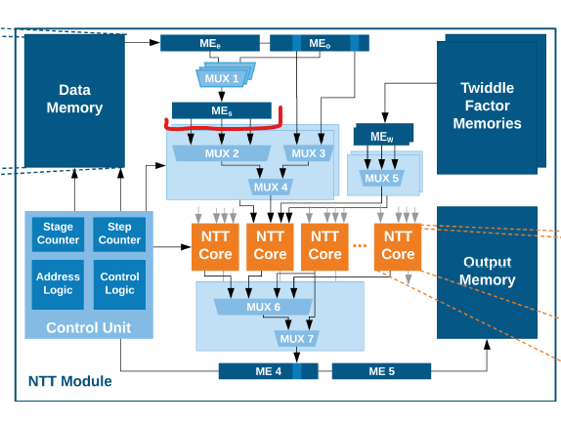
Type 2 stages
First idea: use 2*nCNNT (2-1) multiplexers to choose MEe or Meo and put that in MEs.
Then use 2*nCNNT (2nCNNT-1) multiplexers to pass elements from MEs to cores.
Too complicated and resource intensive

Slide 20
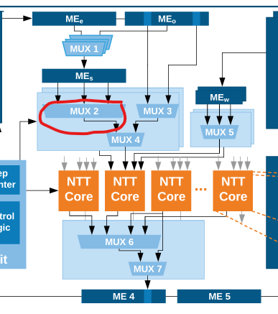
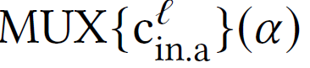
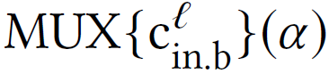
Type 2 stage
Second idea (more efficient): use 4*nCNNT (log 2 nCNNT -1) MUXs to select from MEs. This is MUX2.
Use this equation to determine where to access for each:
=
=

Slide 21
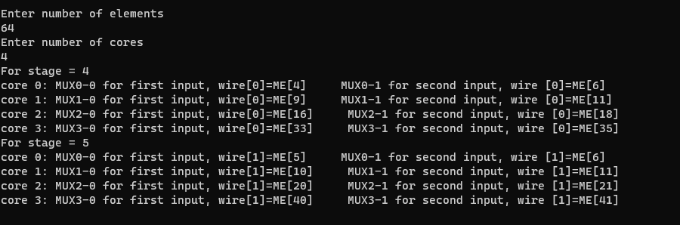
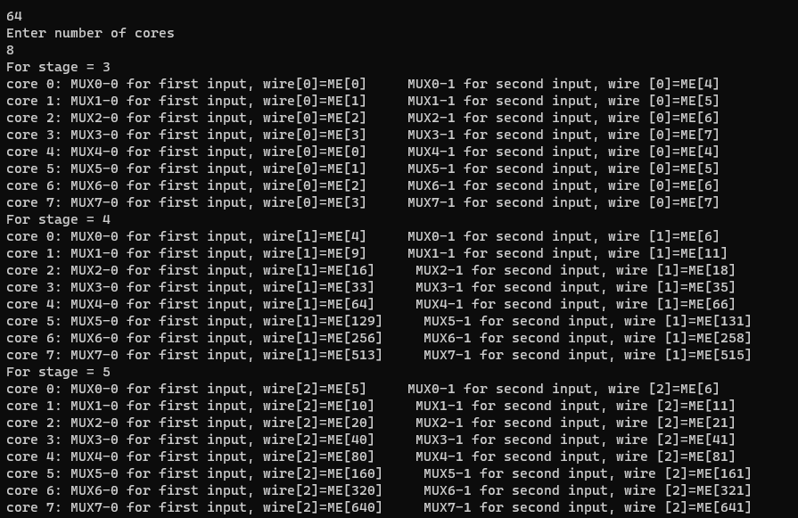
Apply equation
The results of applying the equation show that we actually only have 2*nCNNT multiplexers:
It also shows large indices, where we access 641 different registers here and not all registers are accessed

Slide 22
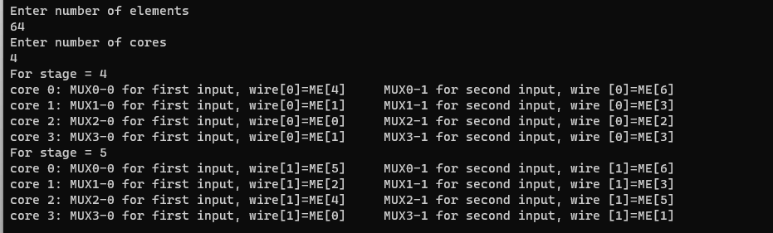
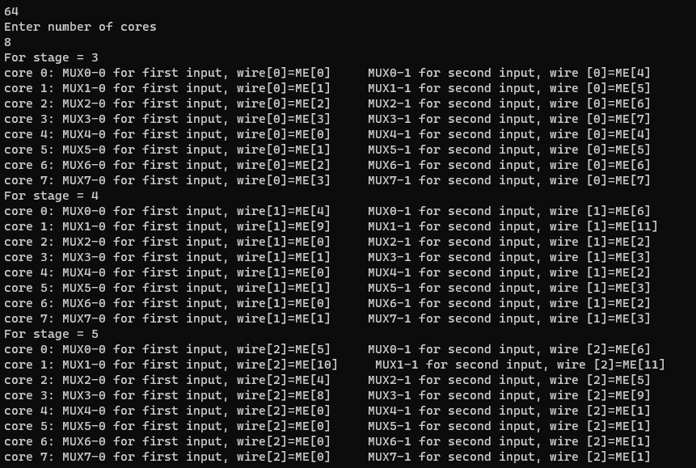
Speculation:
If we apply mod 2*nCNNT we get more logical results that are consistent with the size of MEs according to the type 1 stages steps.

Slide 23
Issues/ next steps:
When applying the mod, we end up with cores that are accessing the same register from MEs. Needs more analysis because it is not practical either to access these large indices since MEs is not supposed to be that large. Could be a simple error in the equation provided or need a different mod.
Work on creating a more encompassing code to perform a butterfly.

Slide 24


Thank you!

